Slide 1

Electronic and Mobile Commerce
Pertemuan 7
Dr. Dedi Trisnawarman

Slide 2
An Introduction to Electronic Commerce
Electronic commerce (e-commerce) is the conducting of business activities (e.g., distribution, buying, selling, marketing, and servicing of products or services) electronically over computer networks

Slide 3
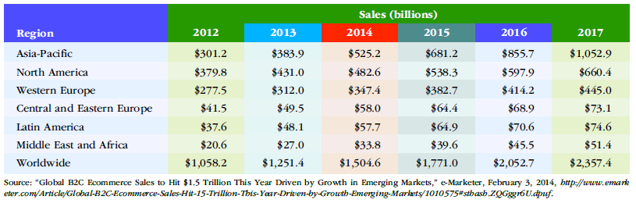
Business-to-Business E-Commerce
Business-to-business (B2B) e-commerce is a subset of e-commerce in which all the participants are organizations.
B2B e-commerce is a useful tool for connecting business partners in a virtual supply chain to cut resupply times and reduce costs.

Slide 4
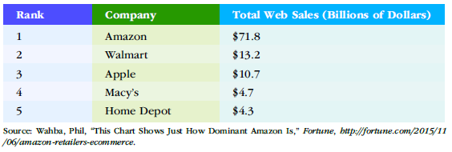
Business-to-consumer (B2C)
Business-to-consumer (B2C) e-commerce is a form of e-commerce in which customers deal directly with an organization and avoid intermediaries.

Slide 5
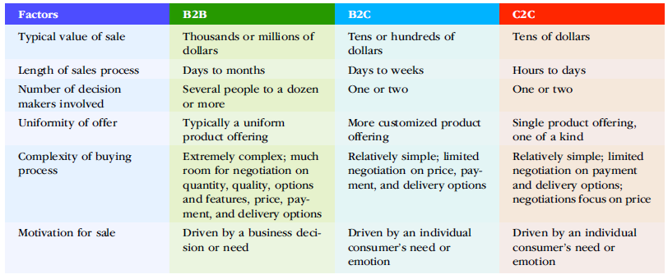
Consumer-to-Consumer E-Commerce
Consumer-to-consumer (C2C) e-commerce is a subset of e-commerce that involves electronic transactions between consumers using a third party to facilitate the process.

Slide 6
Application Programming Interface (API)
application programming interface (API): A set of programming instructions and standards that enables one software program to access and use the services of another software program.
hardware independence: The ability of a software program to run on any platform, without concern for the specific underlying hardware.

Slide 7
Processing Tasks
Multiuser. Allows two or more users to run programs at the same time on the same computer. Some operating systems permit hundreds or even thousands of concurrent users. The ability of the computer to handle an increasing number of concurrent users smoothly is called scalability.
Multiprocessing. Supports running a program on more than one CPU.
Multitasking. Allows more than one program to run concurrently.
Multithreading. Allows different threads of a single program to run concurrently. A thread is a set of instructions within an application that is independent of other threads. For example, in a spreadsheet program, the thread to open the workbook is separate from the thread to sum a column of figures.
Real time. Responds to input instantly. To do this, the operating system task scheduler can stop any task at any point in its execution if it determines that another higher priority task needs to run immediately. Realtime operating systems are used to control the operation of jet engines, the deployment of air bags, and the operation of antilock braking systems—among other uses.

Slide 8
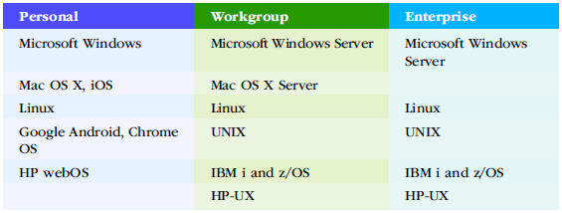
Operating Systems by Sphere of Influence

Slide 9
E-Government
E-government is the use of information and communications technology tosimplify the sharing of information, speed formerly paper-based processes,and improve the relationship between citizens and government.

Slide 10
Introduction to Mobile Commerce
Mobile commerce (m-commerce) relies on the use of mobile devices, such as tablets and smartphones, to place orders and conduct business.
A number of retailers have established special Web sites for mobile devices users.
Advantages of Electronic and Mobile Commerce :
Reach New Customers
Reduce Costs
Speed the Flow of Goods and Information
etc

Slide 11
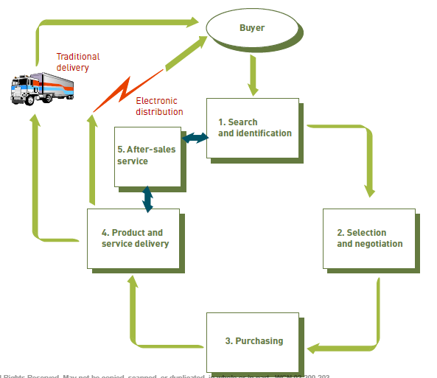
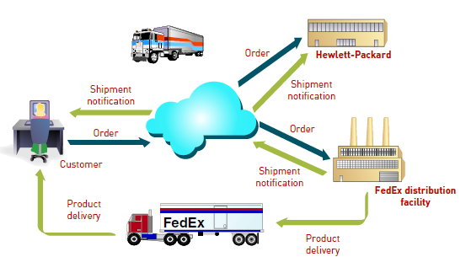
Multistage Model for E-Commerce

Slide 12
E-Commerce Challenges
Dealing with Consumer Privacy Concerns
Overcoming Consumers’ Lack of Trust
Overcoming Global Issues

Slide 13
Electronic and Mobile Commerce Applications
E-commerce and m-commerce are being used in innovative and exciting ways.
Wholesale e-commerce spending now represents more than 40 percent of all wholesale sales revenue, according to a 2015 survey

Slide 14
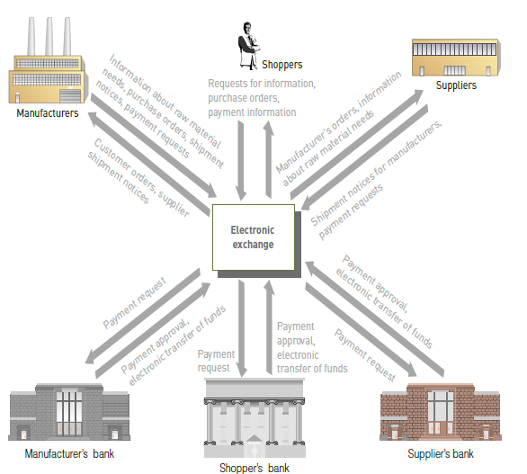
Manufacturing
One approach taken by many manufacturers to raise profitability and improve customer service is to move their supply chain operations onto the Internet.
Manuffactur can form an electronic exchange,

Slide 15
Marketing
The nature of the Web enables firms to gather more information about customer behavior and preferences as customers and potential customers gather their own information and make their purchase decisions.
Internet advertisers use the data toidentify specific markets and target them with tailored advertising messages.This practice, called market segmentation.

Slide 16
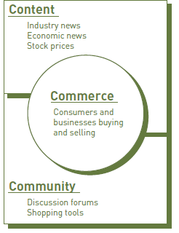
Strategies for Successful E-Commerce and M-Commerce
The first major challenge is for the company to decide on the effective e-commerce model it wants to use and formulate an effective e-commerce strategy.
Companies large and small can establish Web sites, but when building a Web site, you should first decide which tasks the site must accomplish.

Slide 17
Building Website
Defining the Functions of a Web Site
Establishing a Web Site
Building Traffic to Your Web Site
Maintaining and Improving Your Web Site

Slide 18
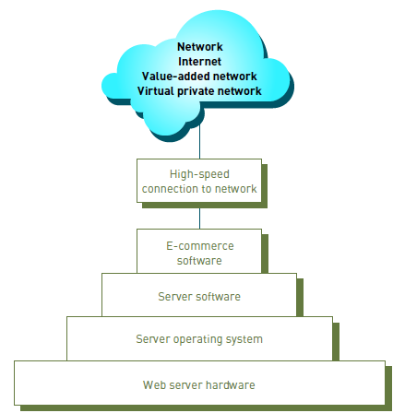
Technology Infrastructure Required to Support E-Commerce and M-Commerce
Hardware - A Web server hardware is a key ingredient to e-commerce infrastructure.
Web Server Software - Web server software is needed to perform fundamental services
Electronic Payment Systems -Current e-commerce technology relies on user identification and encryption to safeguard business transactions

